Slide 1
Evaluation of visible AOD retrievals over the North America using MODIS algorithms
Hiren Jethva^{1,2}, Omar Torres², Yasuko Yoshida³
¹USRA/GESTAR
²NASA Goddard (Code 614)
³Science Systems & Applications, Inc.
TEMPO Aerosol Workshop Sep 11th, 2017

Slide 2
Satellite AOT Data
Aerosol Product/ Algorithm | Level | Characteristics
Dark Target | Level-2 | Level -2 10-km AOT retrievals in the visible bands Retrieval Wavelengths: 470 and 660 nm
Deep Blue | Level-2 | 10-km AOT retrievals in the visible bands
MAIAC | Level-2 | 1-km AOTs in the visible bands
Data Period: 2002-2016
Only “good” and “very good” 470-nm AOT retrievals are considered in the validation study

Slide 3
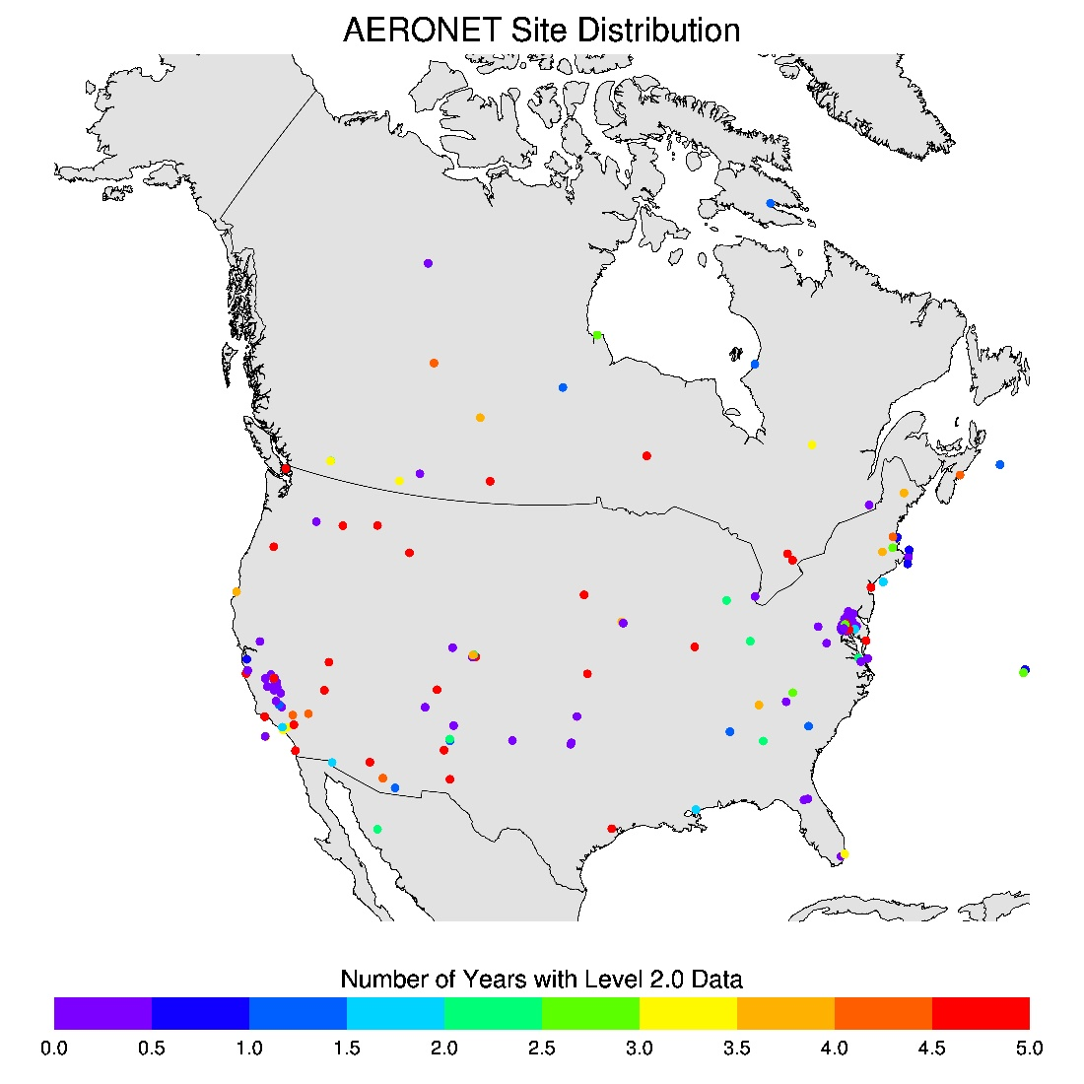
AERONET Data
Region | Number of Sites
Eastern NA | 107
Western NA | 64
Total | 171
DISCOVR-AQ 2011 DC area | 41
DISCOVR-AQ 2012 San Joaquin Valley CA | 14
AERONET Level 2.0 AOTs
(quality-screened and cloud-free)
Data Period: 2002-2016

Slide 4
Co-location Approach
AERONET
+
+
+
+
5 km
10 km
20 km
N_{min}=5
N_{min}=20
40 km
N_{min}=80
ΔT=±15 mins.
ΔT =±15 mins.
ΔT =±15 mins.
N_{min}=320
ΔT =±30 mins.
Satellite overpass time
AERONET direct meas.
+
+
+
+
TWINDOW
ΔT = AERONET time-window

Slide 5
MAIAC vs. AERONET
Eastern N.A. Sites

Slide 8
MAIAC vs. AERONET
Western N.A. Sites

Slide 11
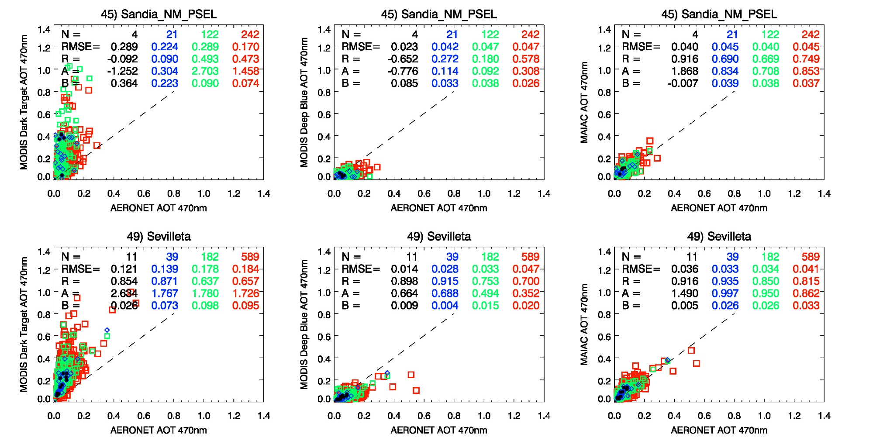

Slide 12
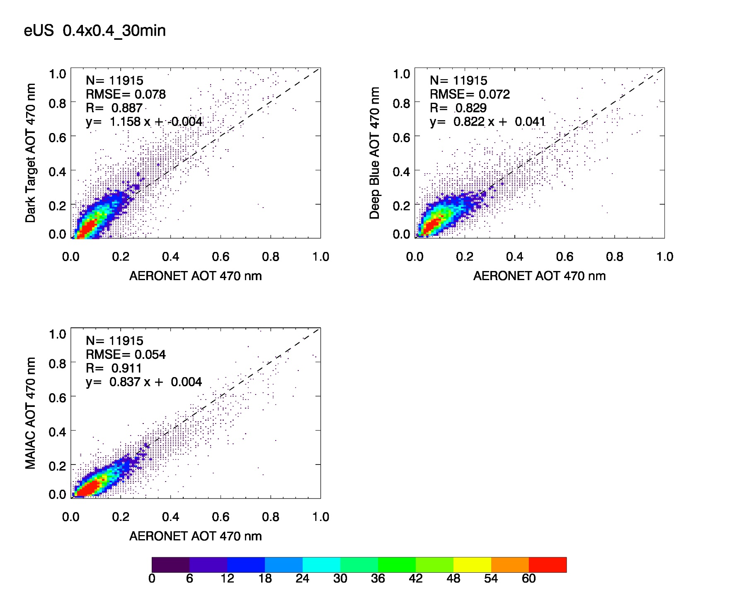
Summary Plots – Eastern N.A

Slide 13
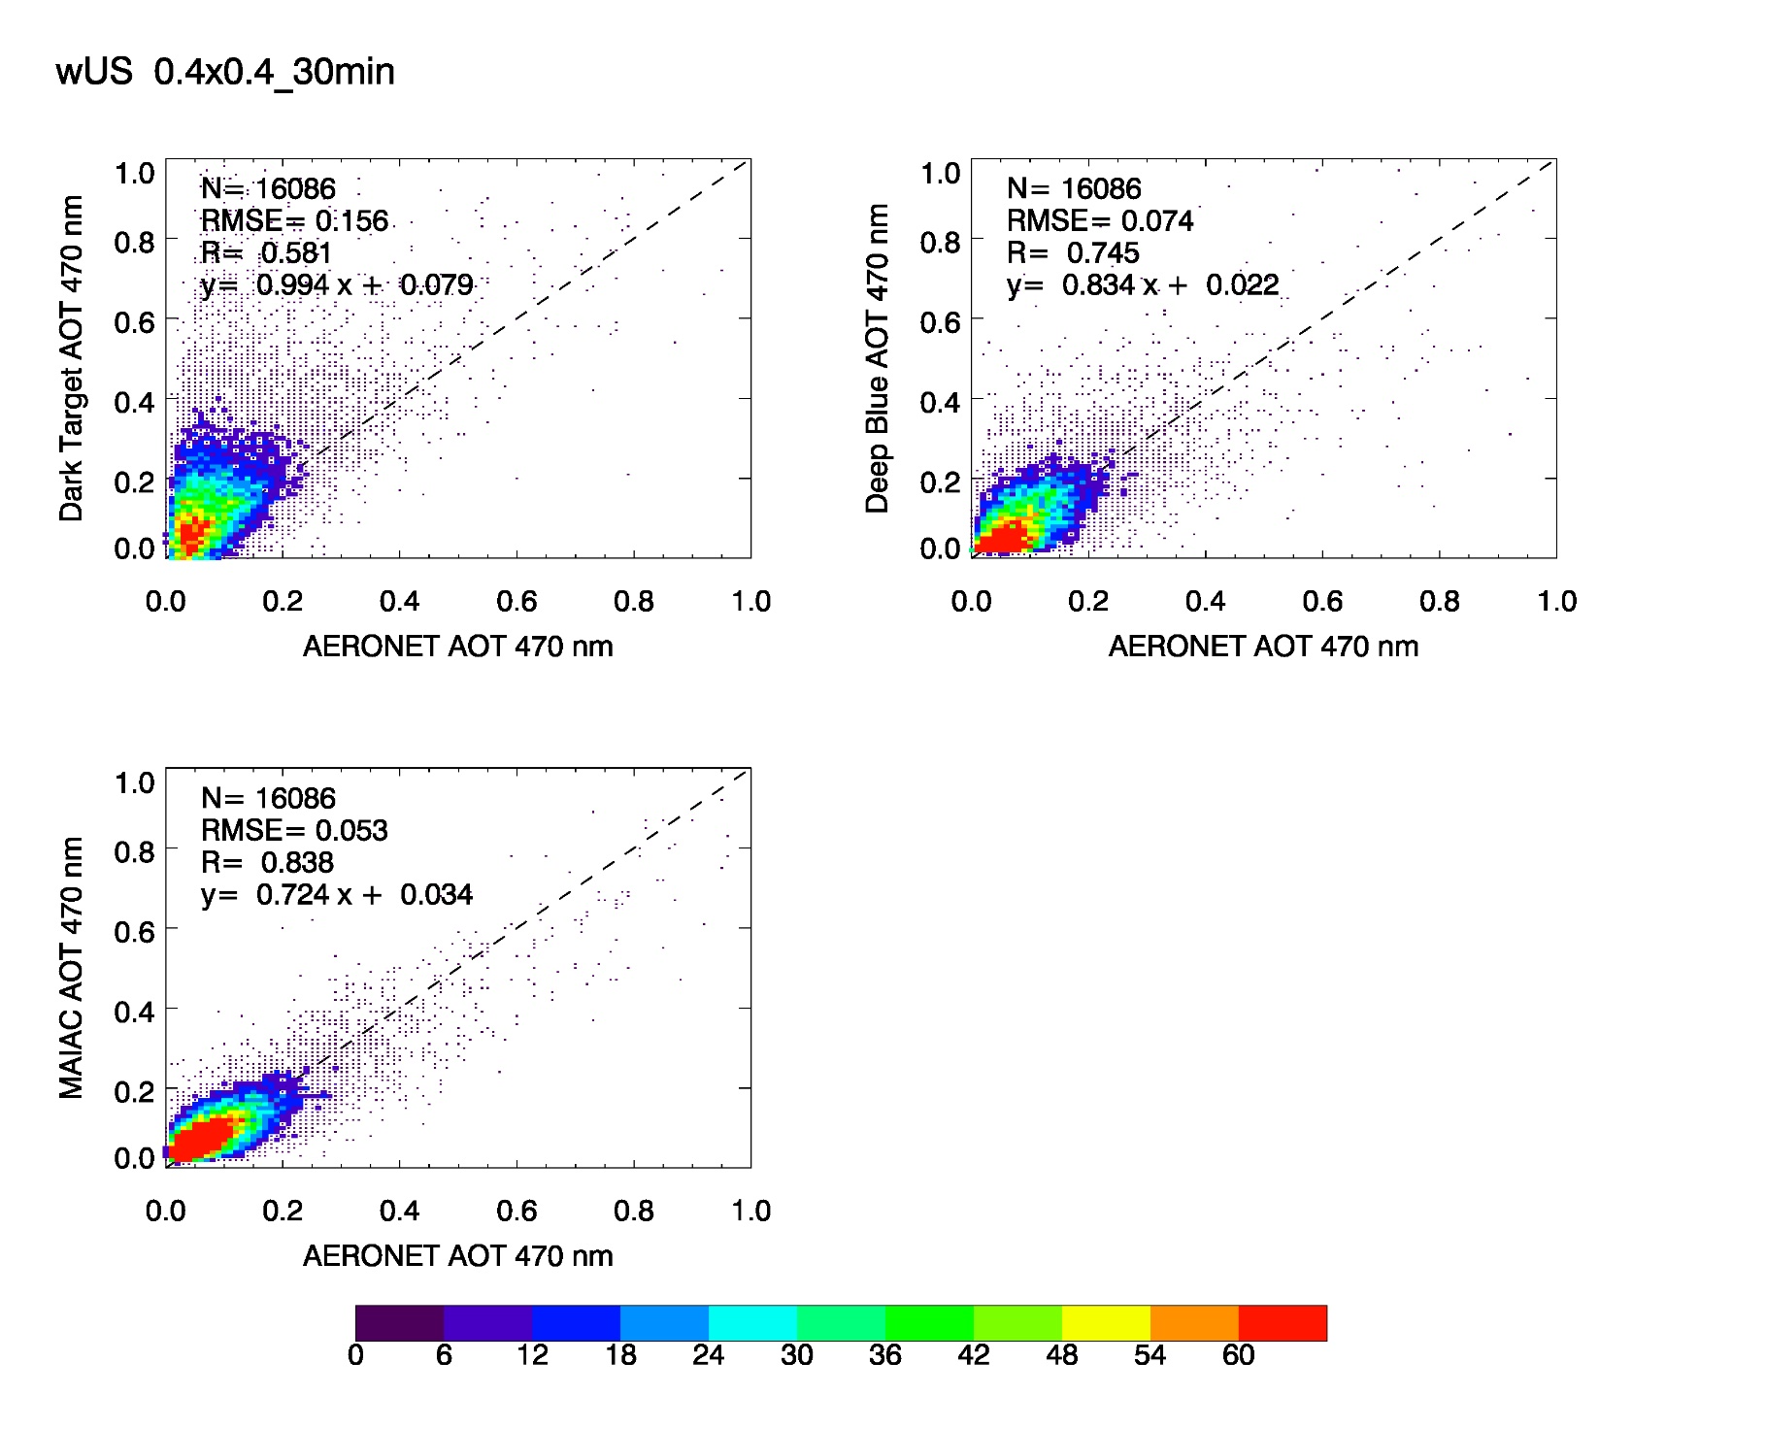
Summary Plots – Western N.A

Slide 14
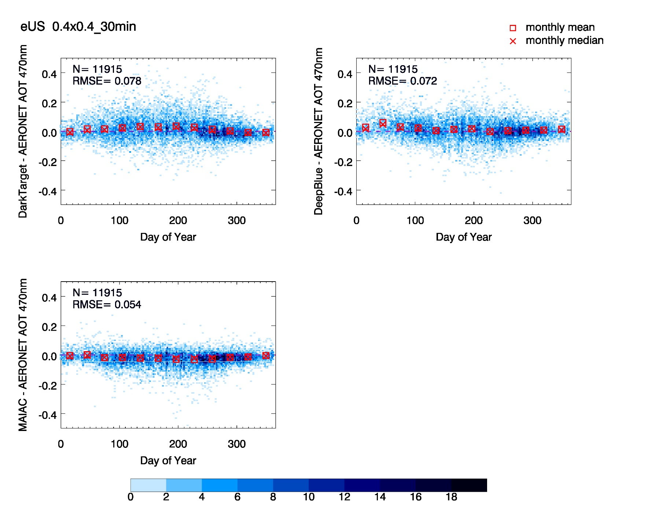
Eastern N.A. Composite – Diff. as a function of DOY

Slide 15
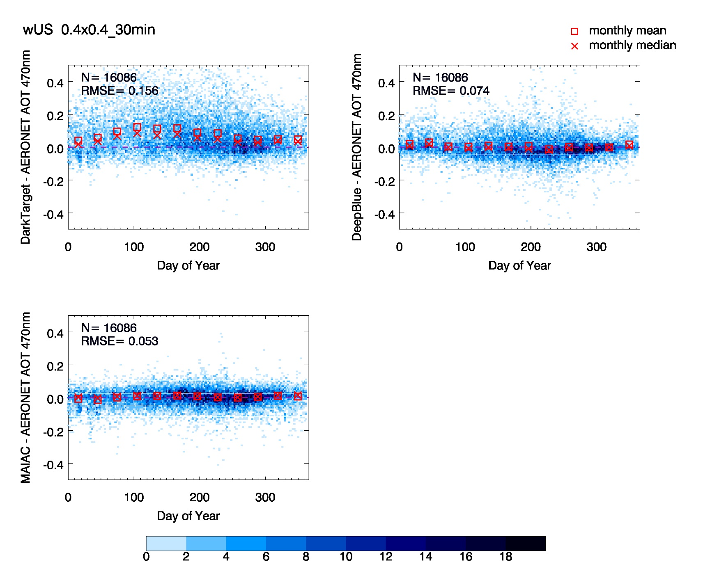
Western N.A. Composite – Diff. as a function of DOY

Slide 16
Summary
Eastern N.A. Sites
 | RMSE | R | Slope | Intercept
Dark Target | 0.078 | 0.887 | 1.158 | 0.004
Deep Blue | 0.072 | 0.829 | 0.822 | 0.041
MAIAC | 0.054 | 0.911 | 0.837 | 0.004
Western N.A. Sites
 | RMSE | R | Slope | Intercept
Dark Target | 0.156 | 0.581 | 0.994 | 0.079
Deep Blue | 0.074 | 0.745 | 0.834 | 0.022
MAIAC | 0.053 | 0.838 | 0.724 | 0.034

Slide 17
Backup Slides

Slide 18
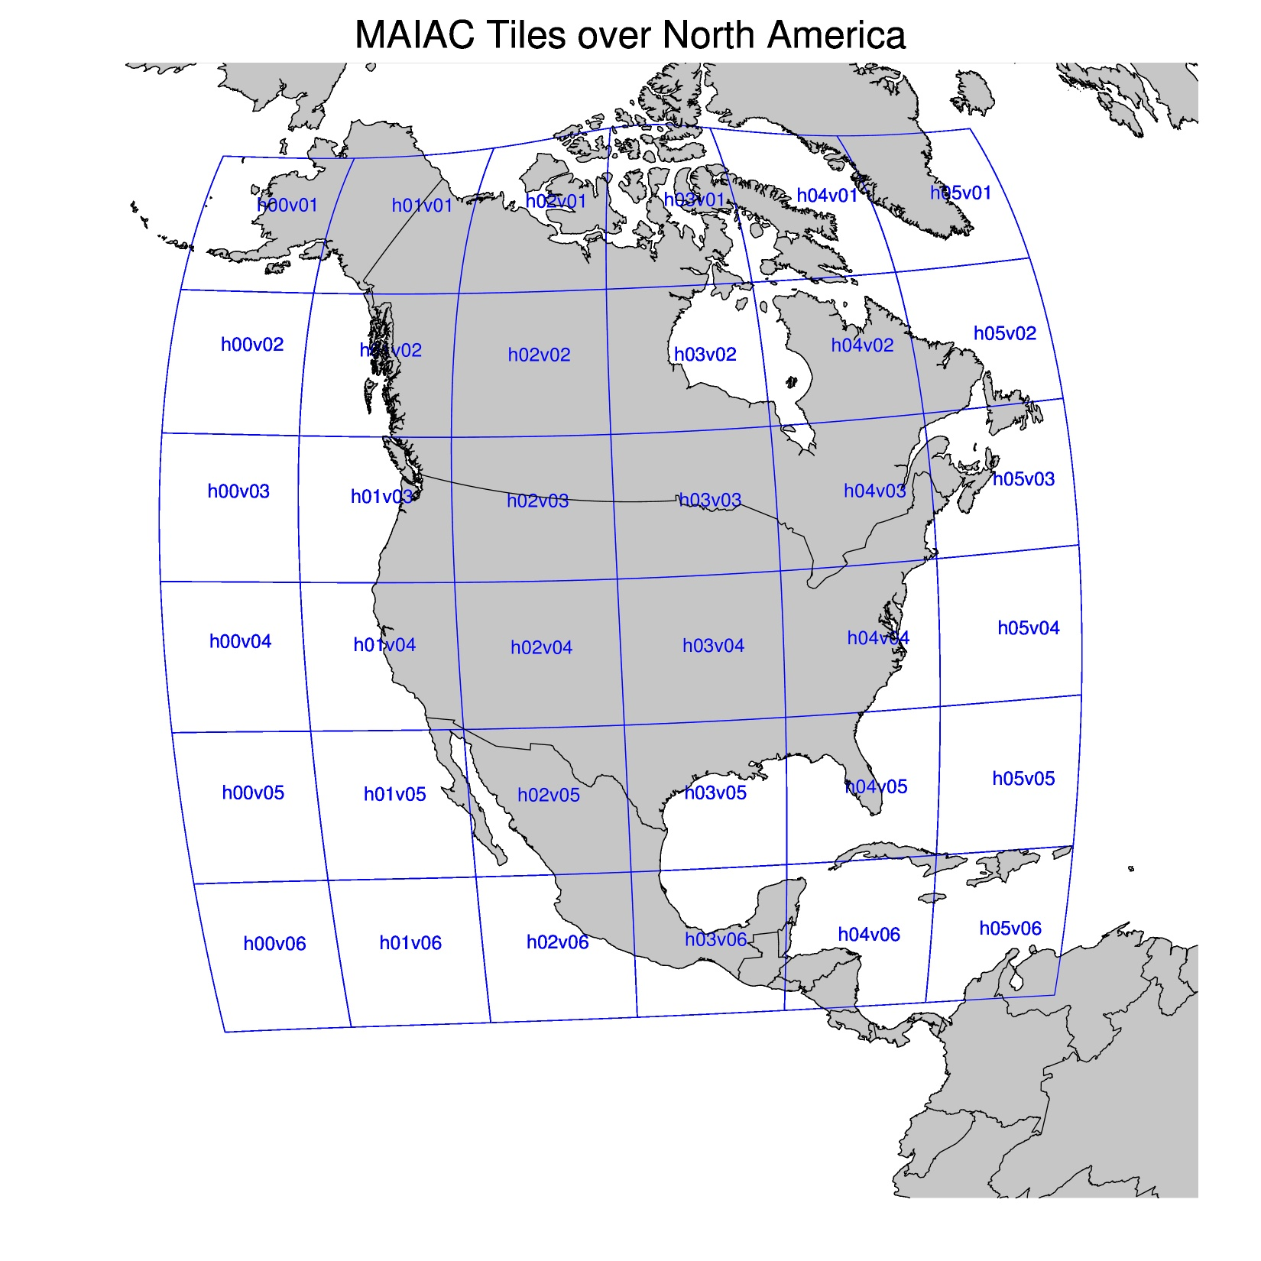

Slide 19
Impact of Spatio-temporal Window
MAIAC
Eastern N.A.
 | RMSE | R | Slope | Intercept
5km_15min | 0.051 | 0.905 | 0.826 | 0.005
10km_15min | 0.054 | 0.902 | 0.844 | 0.002
20km_15min | 0.052 | 0.913 | 0.845 | 0.002
40km_30min | 0.054 | 0.911 | 0.837 | 0.004
Western N.A.
 | RMSE | R | Slope | Intercept
5km_15min | 0.056 | 0.808 | 0.699 | 0.022
10km_15min | 0.052 | 0.811 | 0.710 | 0.026
20km_15min | 0.050 | 0.837 | 0.741 | 0.029
40km_30min | 0.053 | 0.838 | 0.724 | 0.034
For DT → RMSE, R, and Slope improved with averaging for Western N.A; worsen for Eastern N.A.
For DB → RMSE, R, and Slope degraded with averaging for both Eastern and Western N.A.

